Slide 1
British Airways
Customer ratings analysis and insights
01-07-2023

Slide 2
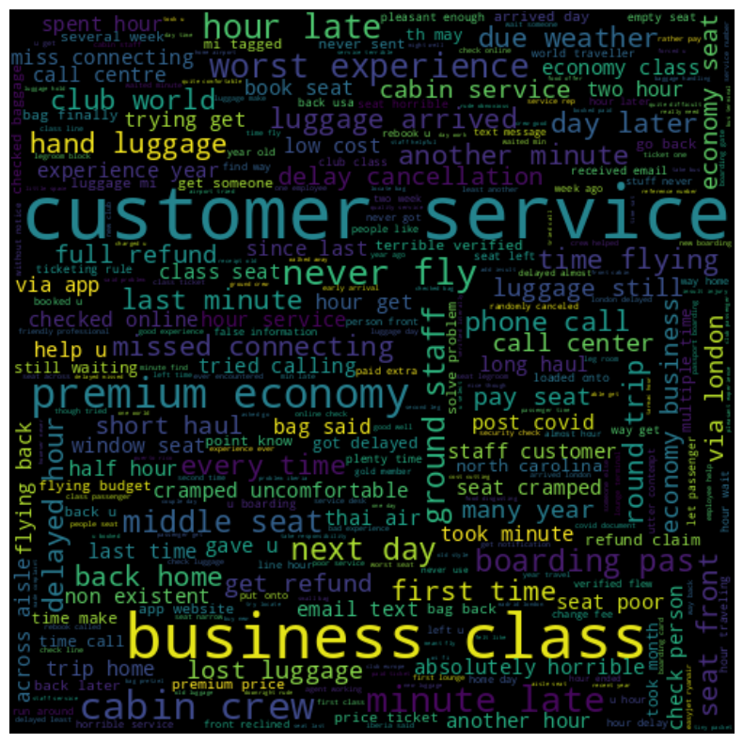
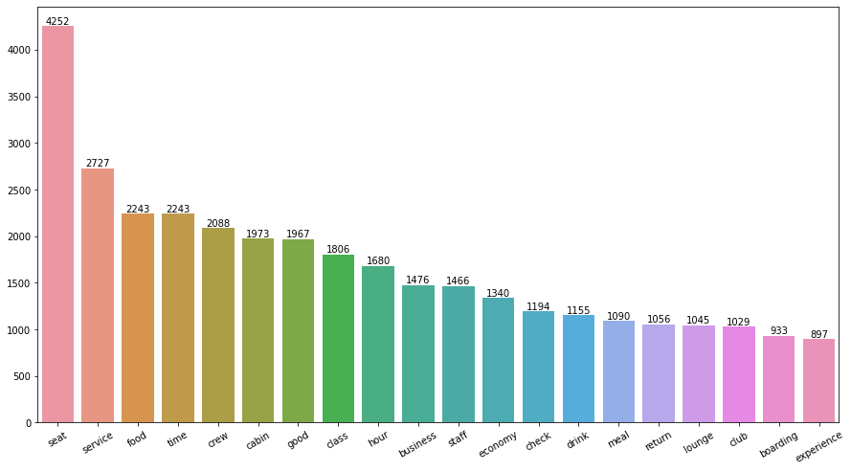
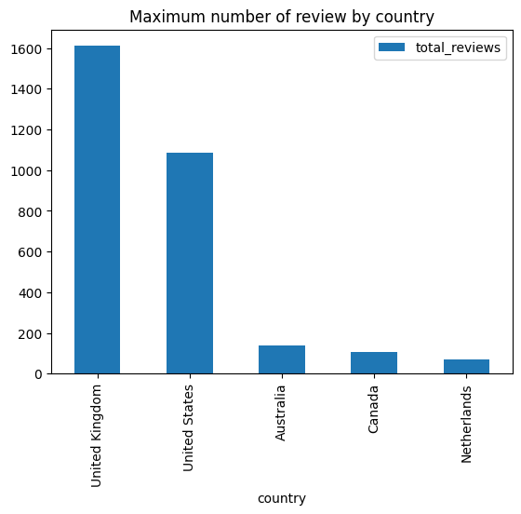
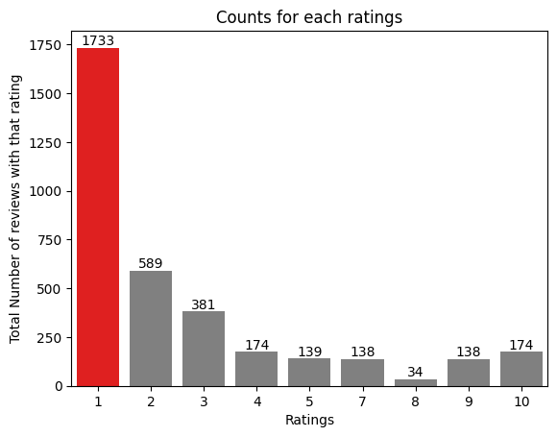
KEY MATRICS
2.76/10
Average overall rating
Review from 18 countries
Review from 18 countries
Collected Review
3500
Focus on – Cabin crew, customer service, poor legroom, flight delays, multiple schedule changes, boarding gate services and specially luggage transfer.
Positive side is that there are not much negative comments about food and entertainment.
What customers are satisfied and unsatisfied about for different ratings class:
7-10 ratings wrote about poor legroom, tatty cabin crew, bad boarding gate service, dirty table
4-6 ratings faced problem with bad staff and customer service, rude staff, terminal change, denied wheelchair assistance
1-3 ratings wrote dissatisfaction on wait for luggage while they liked the food.

